Slide 1


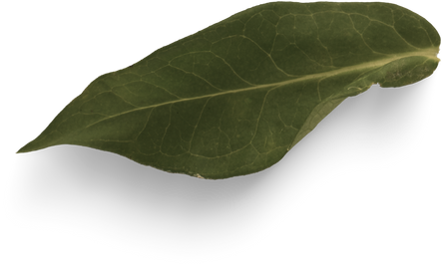

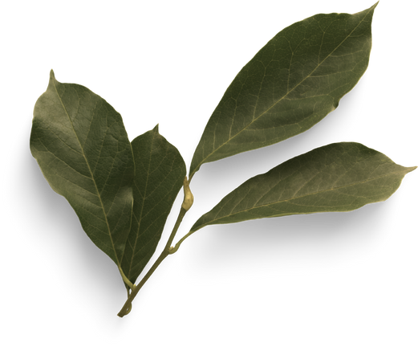
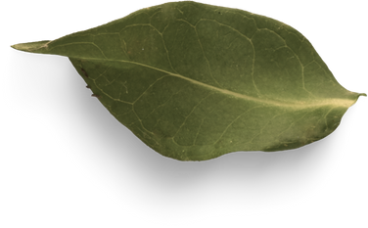
Title of slide
Content Of Slide
ALML_007(Aryan)

Slide 2
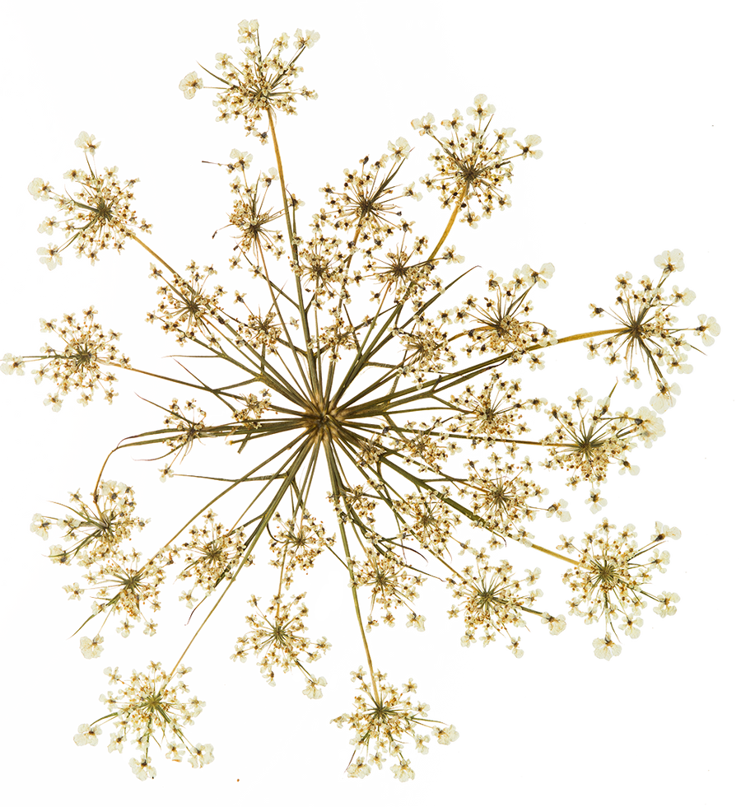
Title
Content
ALML_007(Aryan)

Slide 3


Title
Content
ALML_007(Aryan)

Slide 4
Title
Content
ALML_007(Aryan)

Slide 5
Title
Content
ALML_007(Aryan)

Slide 6
Title
Content
ALML_007(Aryan)

Slide 7
Title
Content
ALML_007(Aryan)

Slide 8
Title
content
ALML_007(Aryan)

Slide 9
Title
Content
ALML_007(Aryan)

Slide 10
Thank
You
ALML_007(Aryan)

